Slide 1
Mutual Fund Portfolio Optimizer
By: Rosie Afsaneh Dabbaghi

Slide 2
Summery
In this project I am trying to maximize growth of the portfolio by entering and exiting 7 different JPMorgan mutual funds. I used 7 JPMorgan funds to cover wide variety of investments.
1. US Large cap fund:OLGCX
2. US Mid Cap fund: OMGCX
3. US Small cap fund: OSGCX
4. Global fund: GAOCX
5. Emerging Markets fund: JEMCX
6. US Income fund: OINCX
7. Mortgage backed fund: OBBCX

Slide 3
I chose all funds from same family fund so there will be not exchange fee by entering and exiting the positions. Historical closing price for each fund will be downloaded as API from Yahoo Finance from 03-01-2020 to 07-10-2023. I will use Algorithmic Trading technique to find Entry and Exit signals to rebalance the Portfolio during economic and market cycles.
I will use SMA 50 and 100 to find Enter/Exit signals
Also I will test the result using SMA 25 and 100.

Slide 4
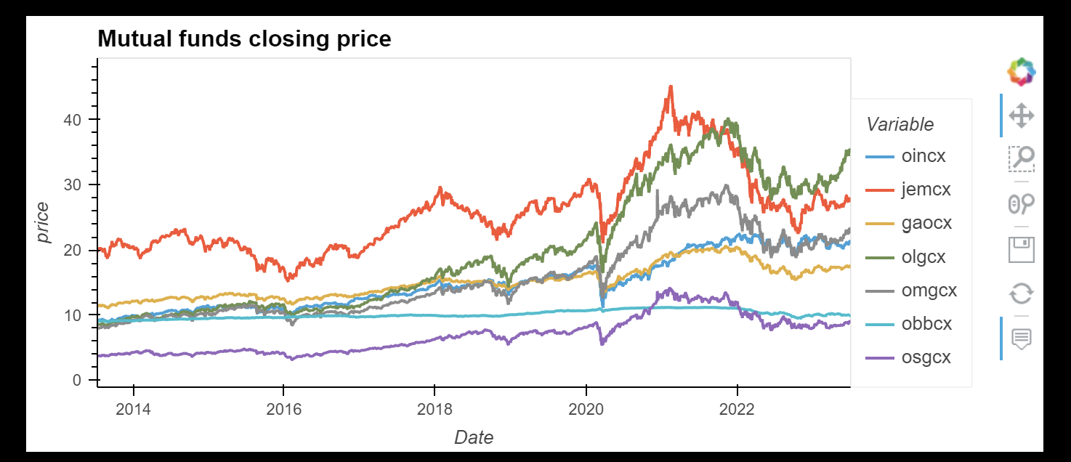
Mutual funds closing price 2013-2023

Slide 5
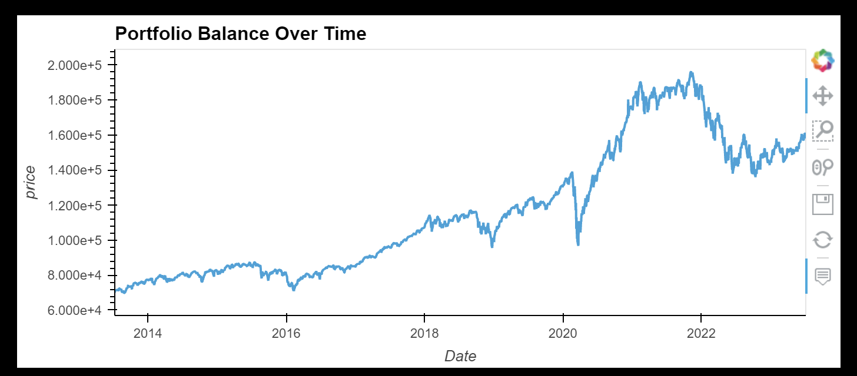
Portfolio Balance over time with fixed Portfolio

Slide 6
Machine Learning to predict 60 of the portfolio
I use Prophet to train my model.
Rolling window was 4 to calculate volatility
Period was 7/10/2013 to 7/10/2023

Slide 7
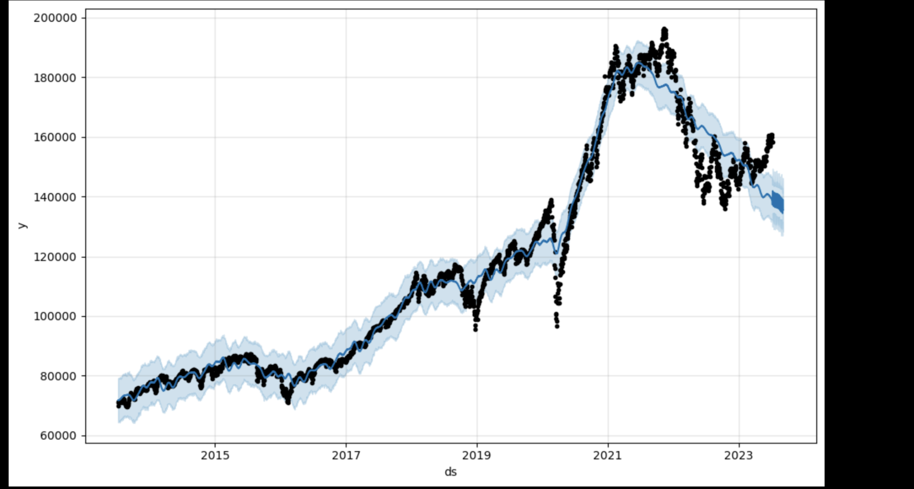
Building portfolio by investing $10000 in each fund

Slide 8
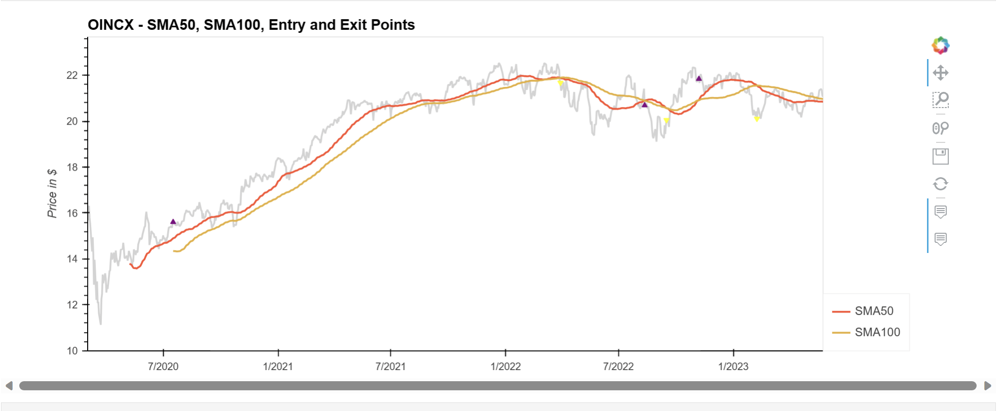
OINCX Enter/Exit Signals

Slide 9
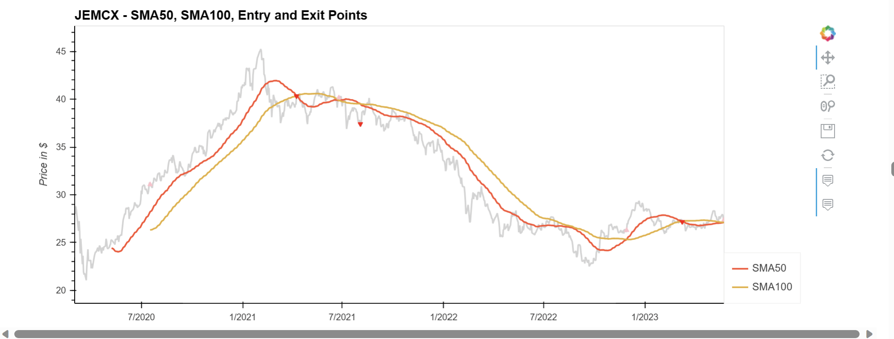
JEMCX Enter/Exit Signals

Slide 10
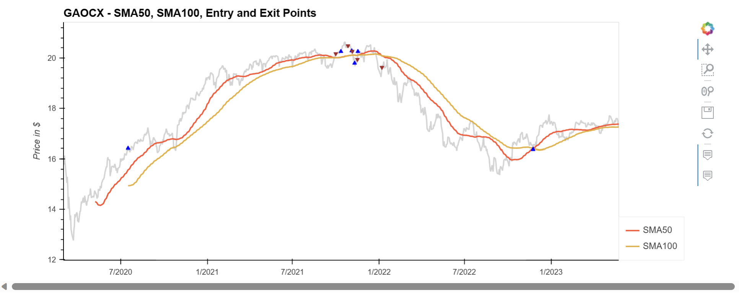
GAOCX Enter/Exit Signals

Slide 11
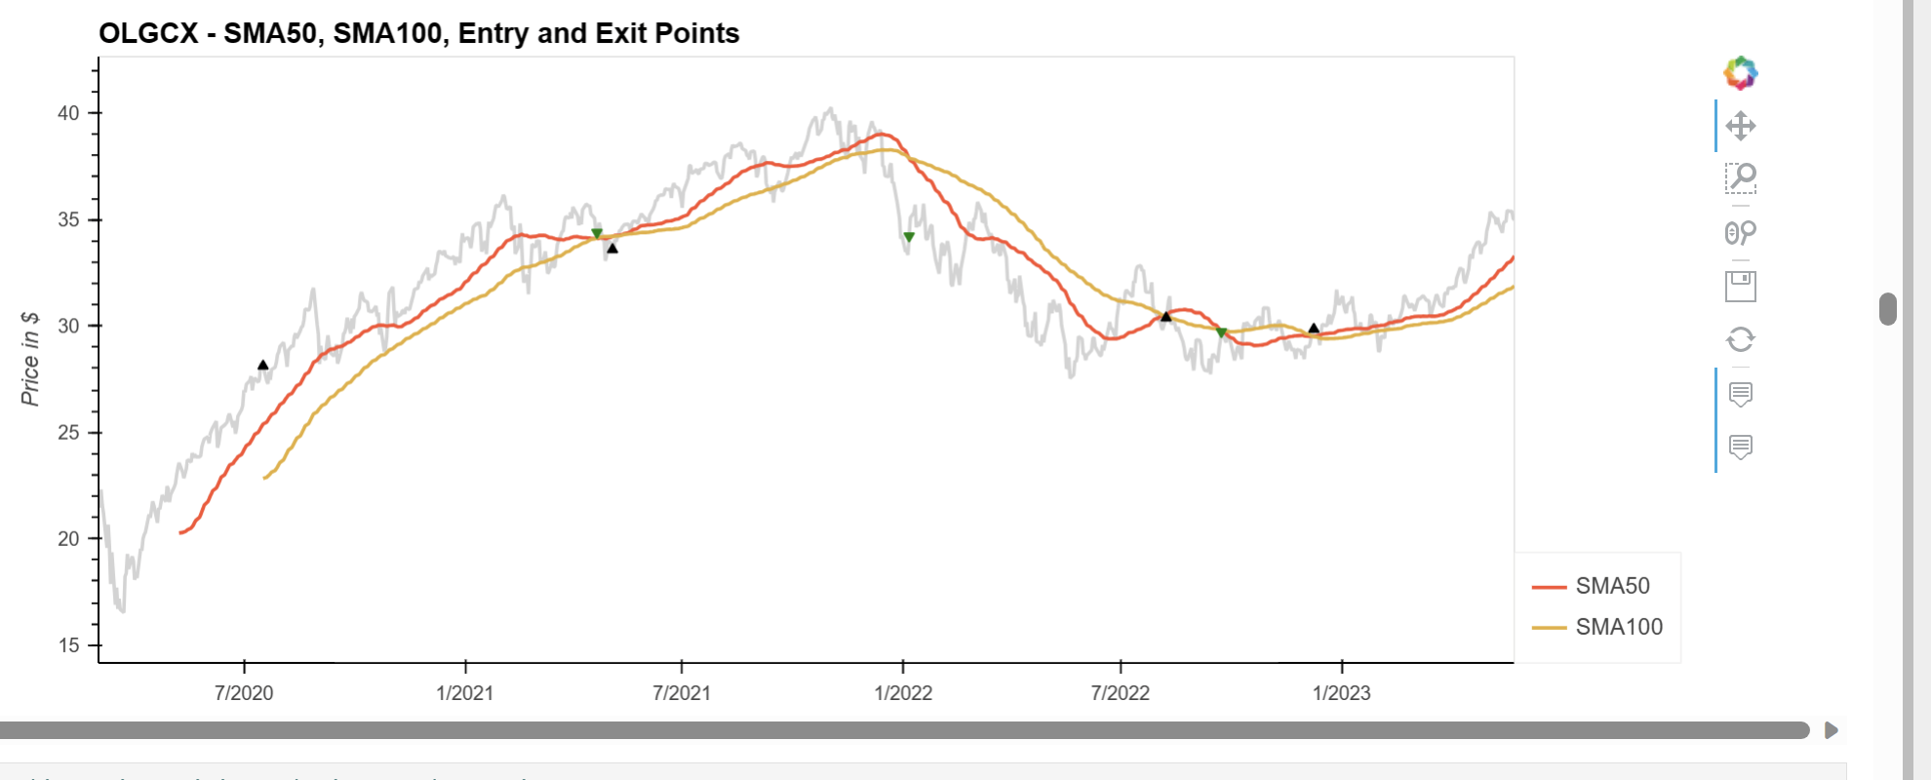
OLGCX Enter/Exit Signals

Slide 12
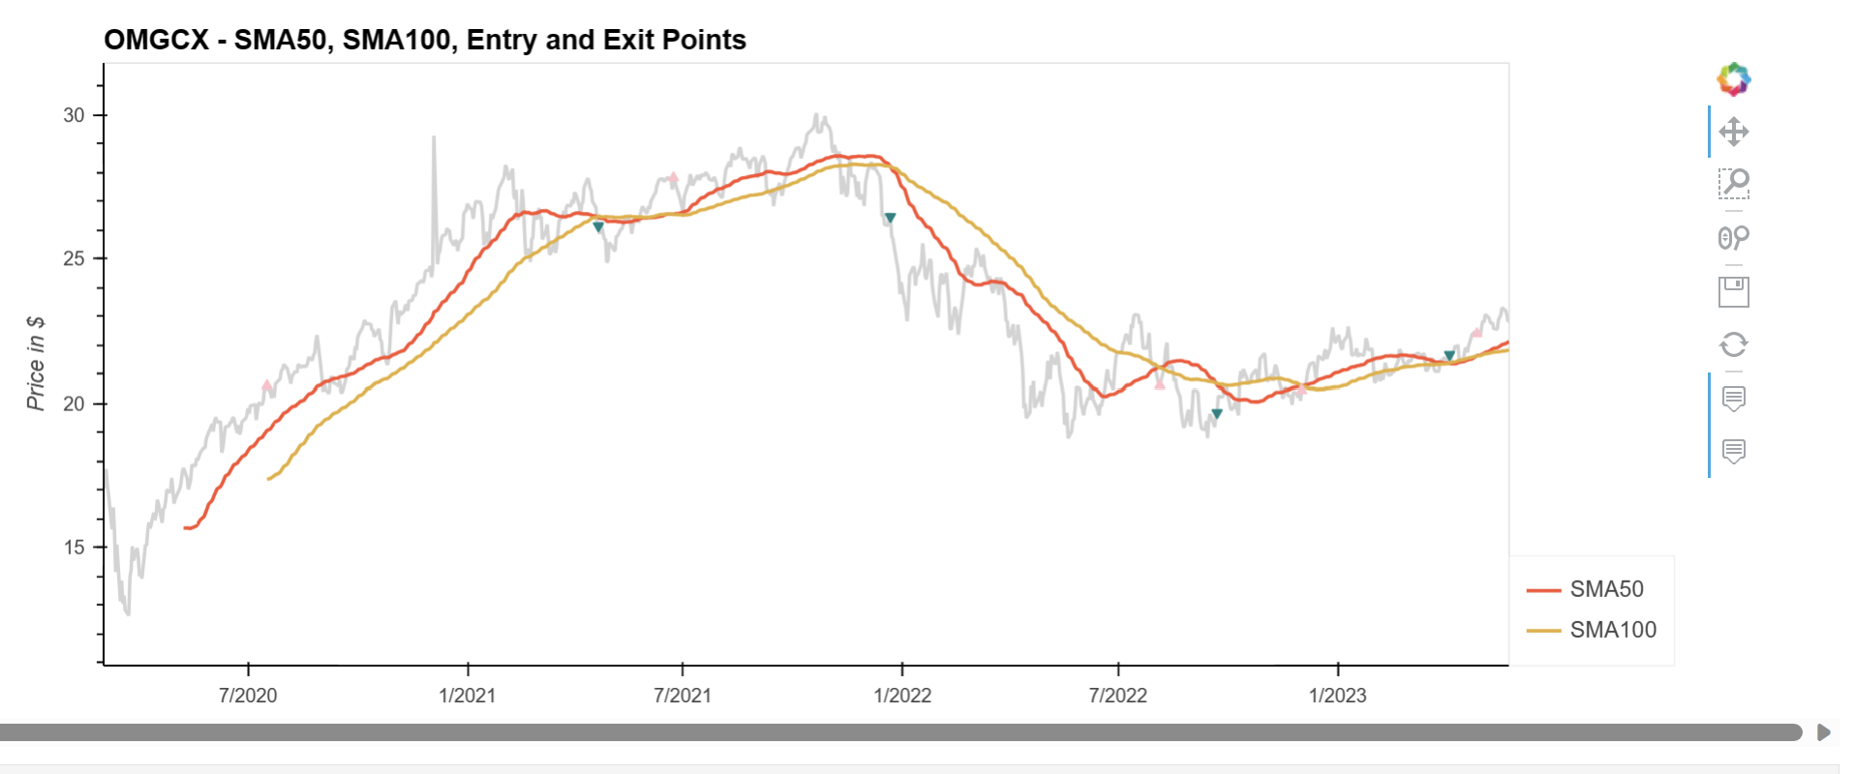
OMGCX Enter/Exit Signals

Slide 13
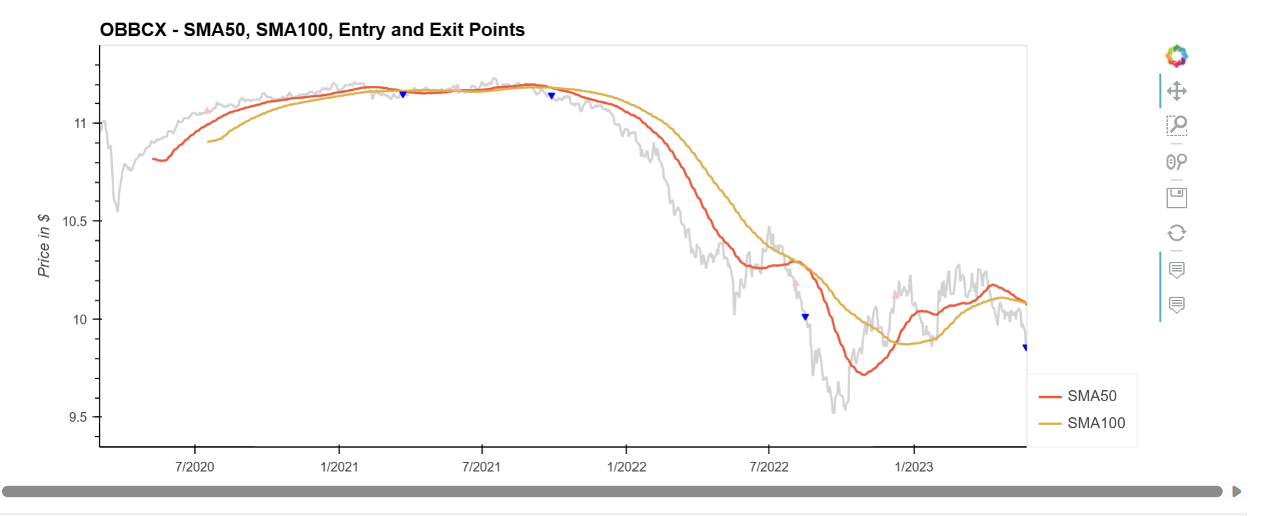
OBBCX Enter/Exit Signals

Slide 14
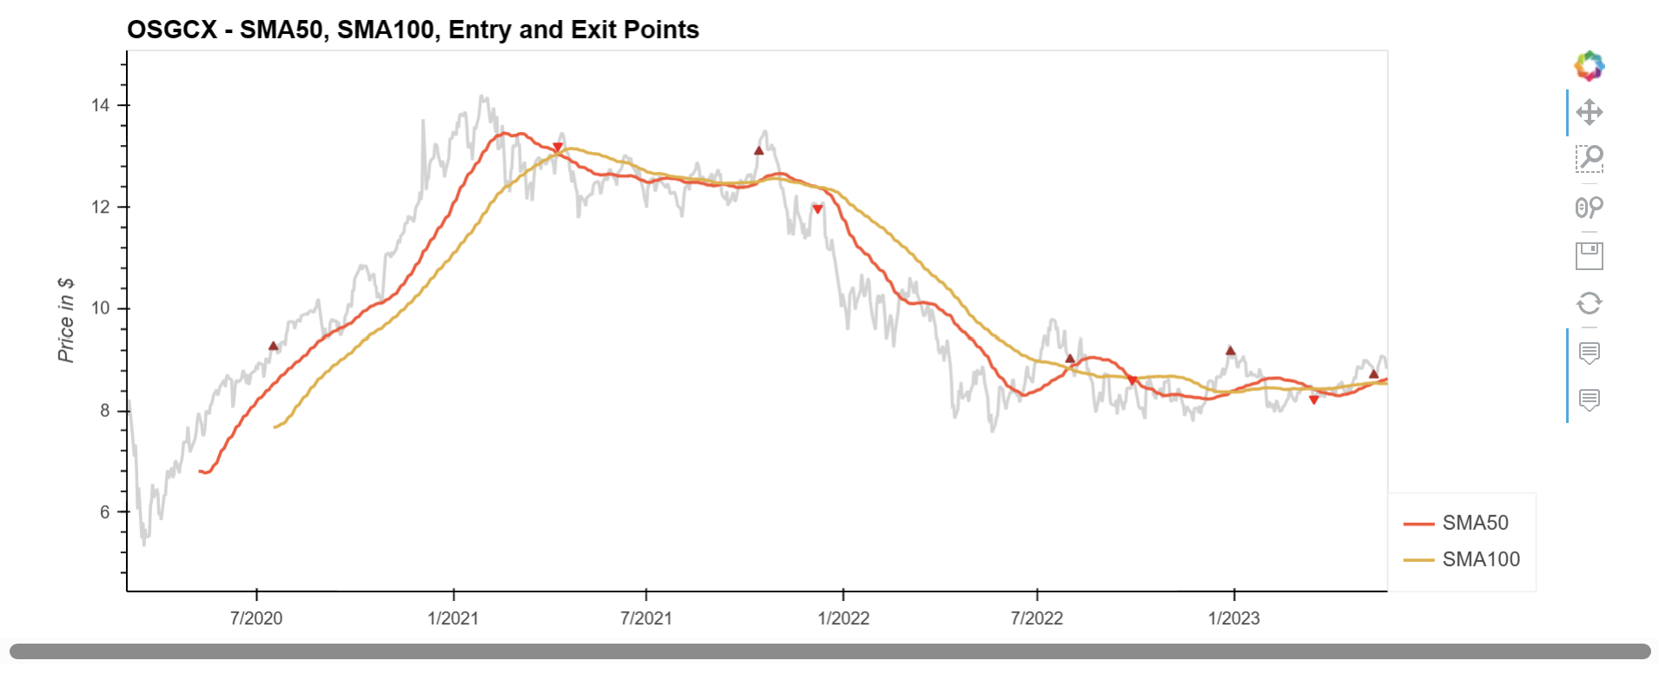
OSGCX Enter/Exit Signals

Slide 15
Trade Strategy
Portfolio Started with investing $10000 in each Mutual fund and keeping $2000 as the cash value.
With each Entry signal if the cash value is over $2000
If the cash value is over $2000 I will buy 300 shares
If the cash value is less than $2000 I will buy 100 shares to make sure there will be enough cash for next signal
With each Exit signal I will sell all of the shares.
After each buy or sell order cash value of the portfolio will be updated
Portfolio value will be calculated after all buy and sell orders are executed

Slide 16
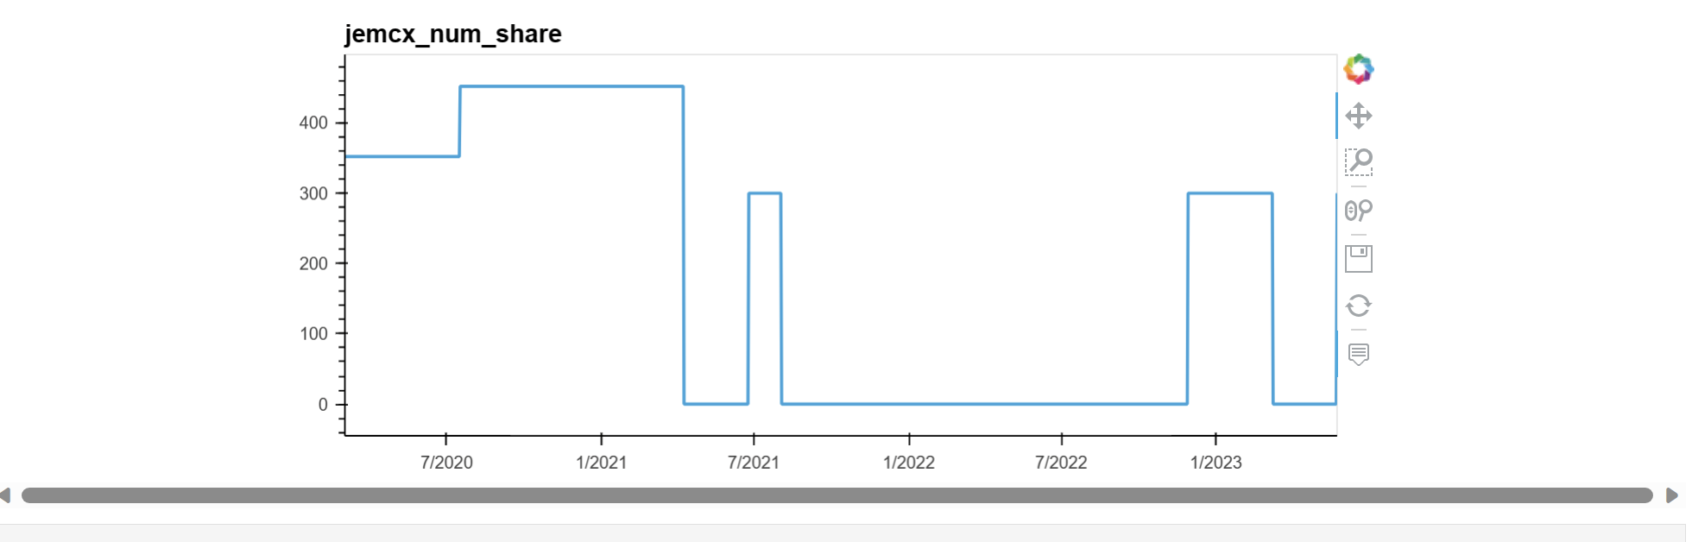
JEMCX number of the shares during trading period

Slide 17
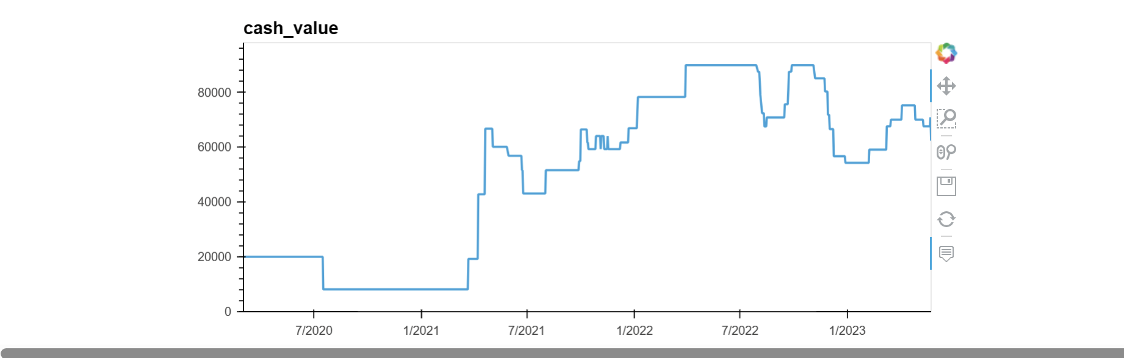
Cash Value of the Portfolio during the trading period

Slide 18
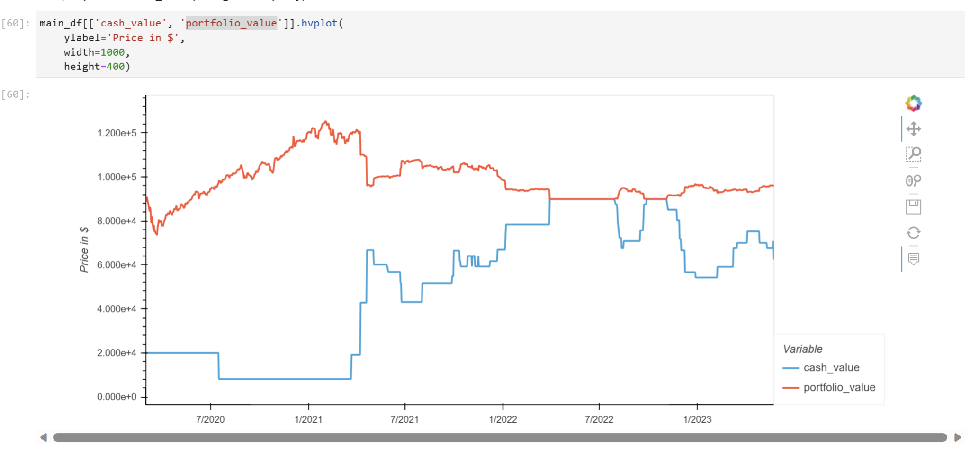
Cash Value and Portfolio Value during trading period

Slide 19
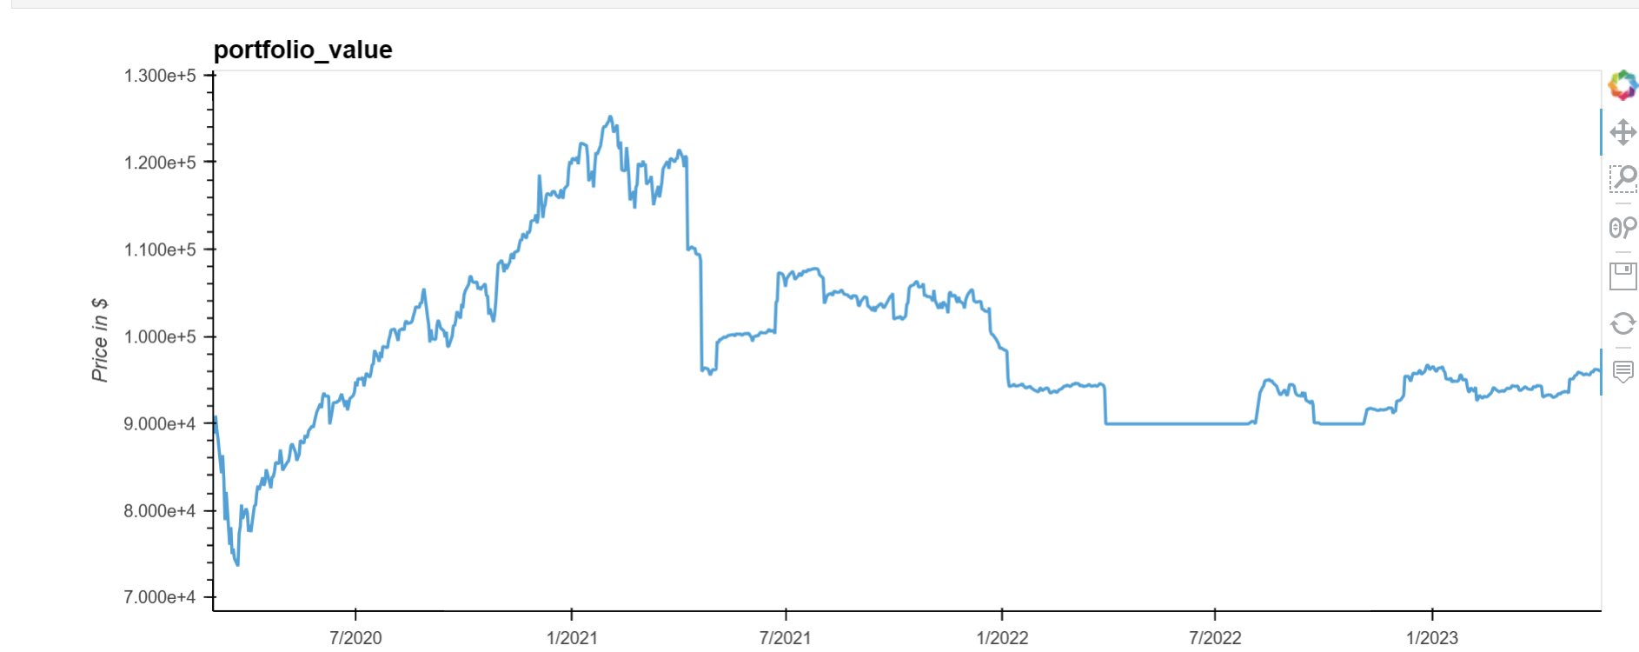
Portfolio Value

Slide 20
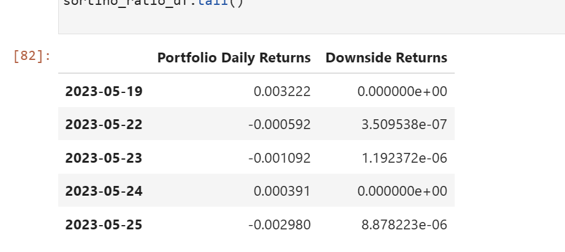
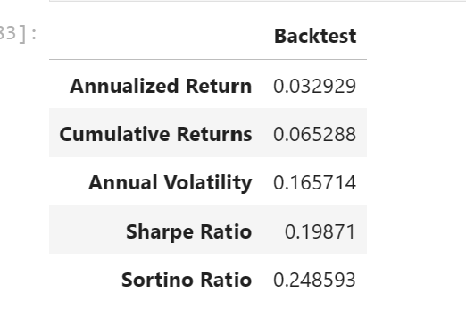
Backtest

Slide 21
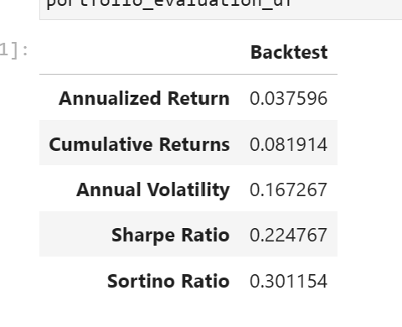
Backtest

Slide 22
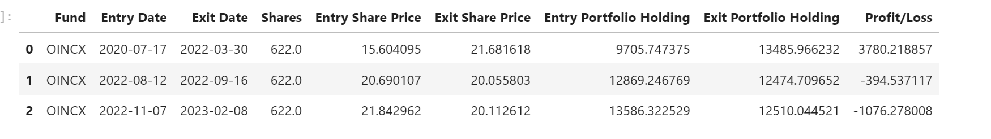
OINCX Backtest

Slide 23
Conclusion and Future steps
Stay invested all the time in a diversified portfolio maybe the best action
Some of the miss performance is because of the trading strategy as I was not investing as many shares as original number of the shares and keep excessive cash in portfolio
The performance can be improved by changing the buy strategy and invest buy more shares when possible. This will be my next step to improve the strategy and performance
Changing the code to more function will improve the code.

Slide 24
Results:
Based on the metrics that the portfolio evaluation DataFrame contains, we can estimate the following:
Annualized return: A portfolio that this trading algorithm manages should yield an annualized return of about 3.29%. That is, the dollar value of the portfolio should increase by about 3.29% each year.
Cumulative returns: The dollar value of the portfolio increased by approximately 6.52% over the backtesting period. We can reasonably expect a similar growth trajectory for the future.
Annual volatility: The annual volatility of the portfolio should have a spread of about 16.57% surrounding the annualized return. This means that the portfolio might return as much as 19.86% (3.29% + 16.57%) or lose as much as −13.28% (3.29% -16.57%) per year.
Sharpe ratio: The Sharpe ratio, which evaluates the performance of a portfolio on a risk-adjusted basis, is 0.198. In general, a higher Sharpe ratio indicates a better risk/reward profile.
Sortino ratio: The Sortino ratio of our portfolio suggests a rate of about 0.248 for the risk-adjusted annual profitability compared to the annual downside risk. As with the Sharpe ratio, a higher Sortino ratio is better. And, it’s best to compare it with the Sortino ratios of other portfolios.
SMA 25 and 100 has better backtest results than 50-100.

Slide 25
Question
Thank you for your time.
Rosie Afsaneh Dabbaghi

